Slide 1
International Bodies to Assist in Tracing and Recovering the Proceeds of Crime
Alex Ferguson
Asset Recovery Lawyer
International Co-operation Asset Recovery Team
Guernsey

Slide 2
Asset Recovery In the Modern World
In majority of criminal cases there will be an international element.
How can investigators and prosecutors obtain assistance in tracing, freezing and recovering the proceeds of crime?
What is the best way to describe international co-operation?

Slide 3
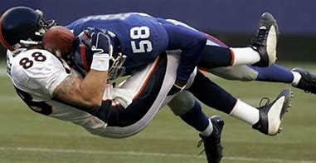
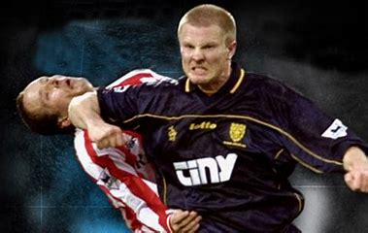
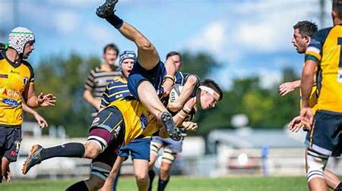
International Co-operation is best described as:

Slide 4
International Bodies
Asset Recovery Networks;
International Association of Prosecutors;
World Bank;
Egmont;
Transparency International.

Slide 5
Asset Recovery Networks
There are currently 8 networks across the globe:
CARIN;
ARIN-AP
ARINSA;
ARIN-EA
ARINWA
RRAG
ARIN-CARIB;
ARIN-WCA

Slide 6

International Association of Prosecutors
Established in June 1995 to tackle transnational crime, particularly drug trafficking, money laundering and fraud;
It has 183 organisational members in over 177 countries representing every continent;
The Network of Anti-Corruption Prosecutors (NACP) is part of IAP;
NACP takes on an active and leading role in the fight against corruption;
It provides a global forum through which prosecutors can exchange experience, identify common challenges & sharing best practice

Slide 7

World Bank – Stolen Asset Recovery Initiative (StAR)
A partnership between the World Bank Group and the United Nations Office on Drugs and Crime (UNODC) that supports international efforts to end safe havens for corrupt funds;
StAR provides platforms for dialogue and collaboration and facilitates contact among different jurisdictions involved in asset recovery;
StAR works with partners around the world to develop the most effective tools to tackle and prevent the theft of assets critical to development;

Slide 8

The Egmont Group
It is a united body of 164 Financial Intelligence Units;
Provides a platform for the secure exchange of expertise and financial intelligence to combat money laundering and terrorist financing;
Can only provide intelligence which can be used to progress a case/investigation but not to be used as evidence.

Slide 9

Transparency International
A global movement with one vision, to free the world of corruption, by giving a voice to the victims and witnesses of corruption;
It has chapters in over 100 countries and an international secretariat based in Berlin;
Can assist with queries relating to ongoing investigations/cases.

Slide 10
Any other international bodies?

Slide 11

Questions?

