Slide 1
PREVENTION OF MONEY LAUNDERING AND TERRORISM FINANCING
Kampala, Uganda, November 2019
Aleksa Veselinov
FIU Serbia

Slide 2
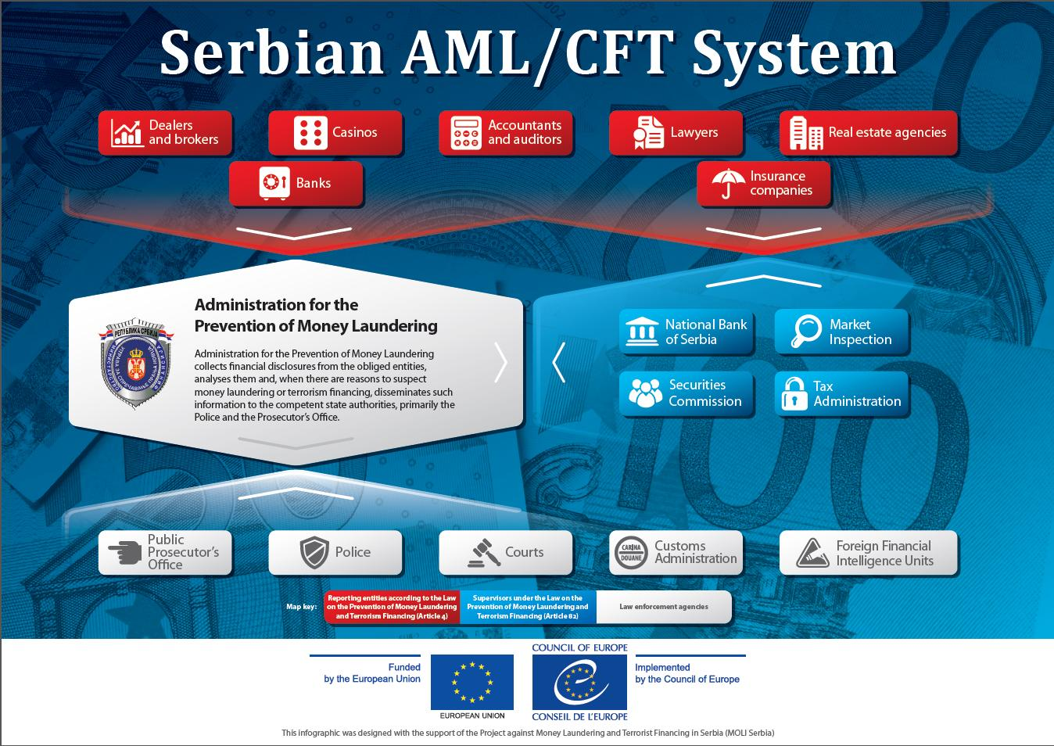

Slide 3
Administration for the Prevention of Money Laundering
An administrative authority within the Ministry of Finance
Serbia’s Financial Intelligence Unit

Slide 4
Financial intelligence
Gathering
Analysis
Dissemination

Slide 5
APML’s work
Based on STRs
At the initiative of another state authority
Based on APML’s information
At the initiative of a foreign FIU

Slide 6
Obliged entities
Banks
Lawyers
Real estate agents
Exchange offices
Public postal operator
Investment funds
Accountants
Broker-dealer companies
друштва
Payment institutions
Organizers of games of chance in casinos
Tax advisors
Voluntary pension funds
Organizers of games of chance on the internet
Factoring companies
Leasing companies
Auditors
Notaries
Insurance companies
Money transfer agents
Traders in virtual currencies

Slide 7
A suspicious transactions
Analysis of data contained in databases
Additional data obtained from obliged entities, if necessary
Databases of other state authorities
A request to FIU
Dissemination of reports

Slide 8
Initiative of a state authority
Well-explained and in written form
Article 77 of AML/CFT Law

Slide 9
APML’s Powers
Monitoring financial operations of a customer
Temporary suspension of a transaction
Requesting data from obliged entities

Slide 10
Monitoring financial operations of a customer
3 to 6 months, at the longest
It usually precedes a suspension of transaction
Obliged entity must act according to APML’s instructions.

Slide 11
Temporary suspension of a transaction
72 + 48 hours
Written order
In urgent cases, verbal order.

Slide 12
INTERNATIONAL COOPERATION
Egmont Group
174 members
APML’s powers apply (exchange of data, monitoring, suspension of a transaction)
Member of MoneyVal Committee
Observer in EAG

Slide 13
International cooperation
Mostly with countries in the region and countries with large diaspora
Highly-rated cooperation

Slide 14
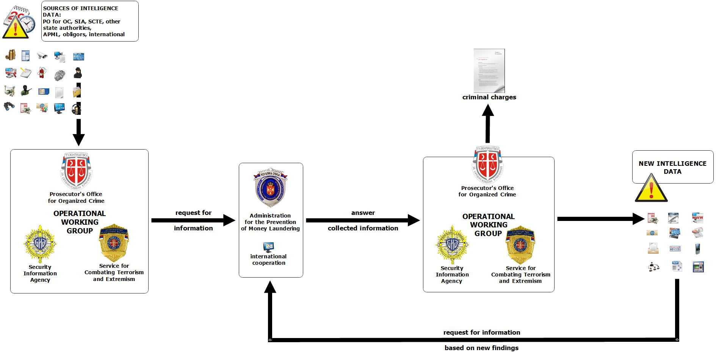
CTF Information Exchange

Slide 15
Strategic Documents
National Risk Assessment of Terrorist Financing with Action Plan
National Risk Assessment of Money Laundering with Action Plan
National Strategy Against Money Laundering and Terrorism Financing with Action Plan

Slide 16
National Risk Assessment of Terrorist Financing
Risk: MEDIUM
Highest level of threat: FOREIGN TERRORIST FIGHTERS

Slide 17
National Risk Assessment of Money Laundering
Overall risk: MEDIUM
The most vulnerable sectors:
  FINANCIAL: banks, exchange offices and payment service providers
  NON-FINANCIAL: real estate, games of chance and accounting agencies

Slide 18
National Risk Assessment of Money Laundering
Predicate criminal offenses classified as high-level threats:
  tax offenses,
  abuse of the position of the responsible person,
  abuse of office and illicit production and
  circulation of narcotic drugs.

Slide 19
Financial Intelligence Unit Serbia
33 ML convictions in 2018 and 2019.
TF convictions: 1 in 2018
Search engine for UN designated persons and domestic designated persons on the APML website.

