Slide 1


CARIN & the regional ARIN’s
Informal
English speaking
Judicial & law enforcement
CARIN
58 jurisdictions, 37 members & 21 observers
7 regional networks
9 organisations

Slide 2
CARIN & the regional ARIN’s

Slide 3
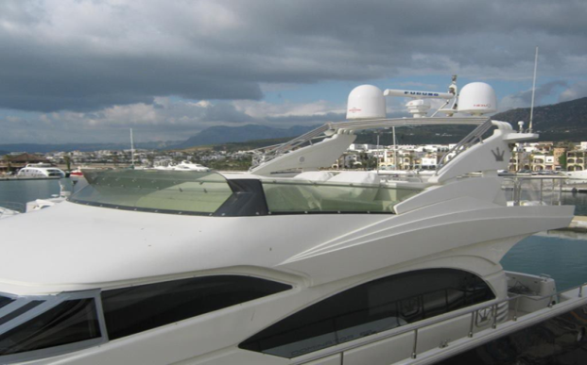

Case example CARIN 2014 -2018 Spain – Guernsey
Type of Request: Selling motor yacht
Type of Offence: Corruption/ Importing 1213 kilos cocaine
value 2.516.000 Euro
Suspect: Spanish National
Investigation Period: 2014 -2016
Value of Asset: 209.124,03 Euro
Outcome: 2018 Amount transferred to Spanish authorities by Guernsey authorities

Slide 4
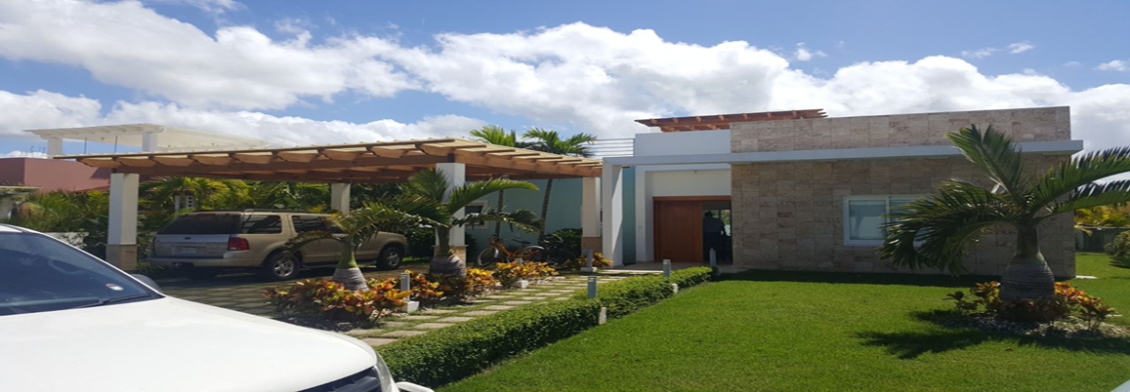
Case example 2017 CARIN - ARIN-CARIB Denmark – Dominican Republic
Type of Request: Identify real estate
Type of Offence: Drug trafficking – 50 kilos of amphetamine
Suspects: 2 Danish nationals
Investigation Period: February – August 2017
Value of Asset: USD 400.000
Outcome: Property currently seized and authorities awaiting the confiscation judgement

Slide 5
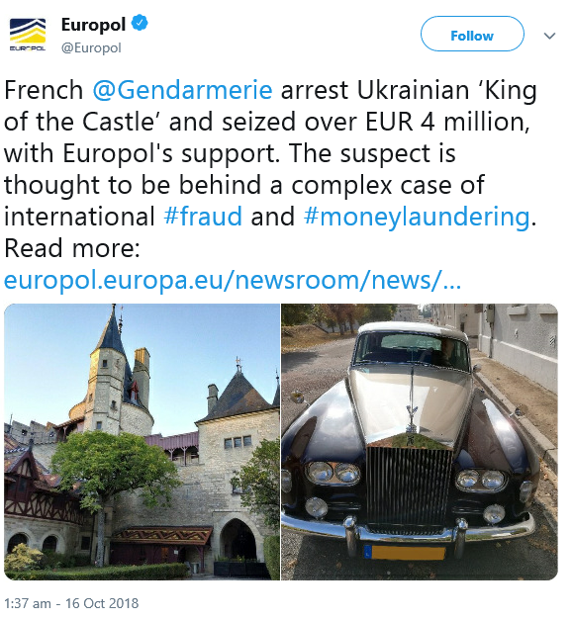
Case example 2018 France -Ukraine

Slide 6
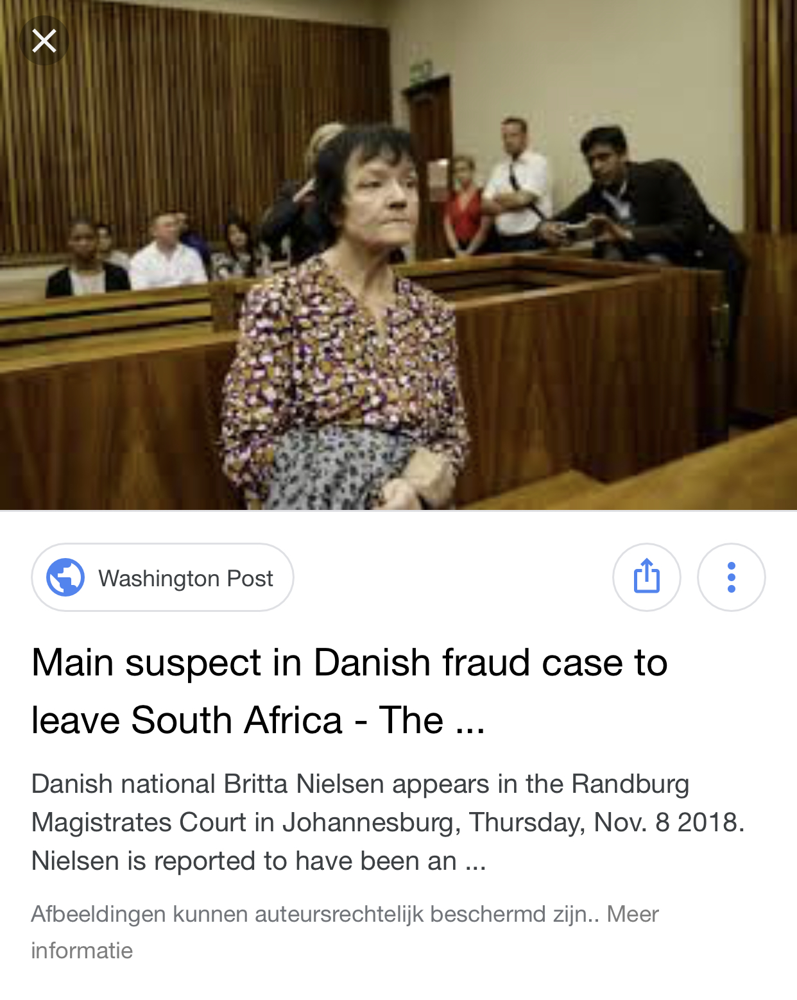
Case 2018
Denmark - South Africa

Slide 7
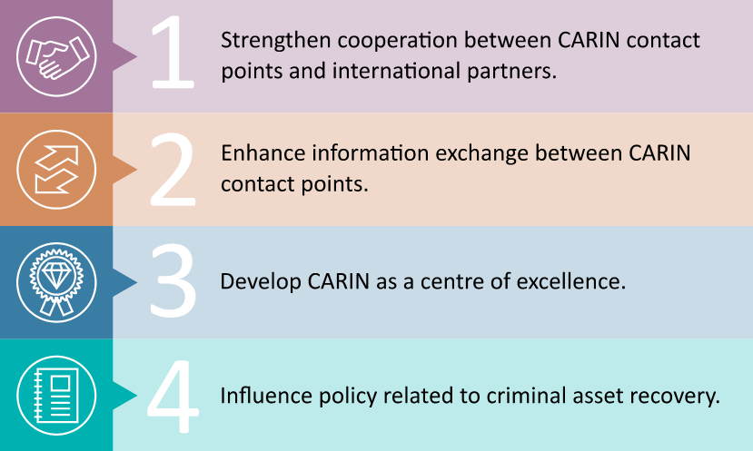
Four strategic goals

